Slide 1
Gesture Based Real-time Indian Sign Language Interpreter
Presented By: Under Guidance of:
Rushikesh Bailkar ( BE A 04). Dr. Chhaya S. Pawar
Akshay Divkar (BE A 75)

Slide 2
Contents
Introduction
What is Sign Language ?
Why we need SLR ?
How SLR will help ?
Review of Literature
Summarized Findings
Disadvantages of Existing system
Problem definition
Objectives
Proposed system
Advantages of Proposed system
Conclusion
References

Slide 3
Introduction
The Sign Language (SL) is a method of communication for Speech/Hearing impaired.
Sign language is well structured gesture code, each gesture has a meaning assigned to it.
In the past several years there is increase in interest in sign language recognition.
Speech/Hearing impaired people rely on sign language interpreters for communications. in day to day tasks it is difficult to rely on them.
The propose system is able to recognize hand gestures accurately with use of webcam using bare human hands and convert it into text message.
The aim of this project is to recognize the gestures with highest accuracy and in least possible time and translate into the corresponding word in a vision based setup.

Slide 4
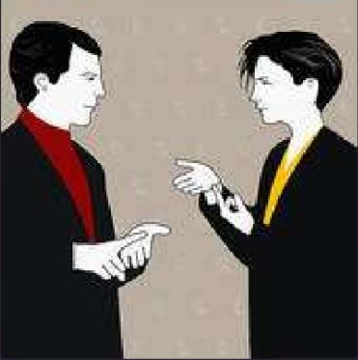
What is sign language ?
Communication language used by
Hearing impaired people.
Uses different medium such as hands,
face or eyes rather than vocal tract or
ears for communication purpose

Slide 5
Why we need SLR ?
Problems :
About 2 million people are hearing impaired in the world.
They are deprived from various social activities.
They are under estimated to the society.
Communication problem.

Slide 6

How SLR will help? (An Example)
Suppose a Speech impaired person went to
doctor. And she is trying to tell her problem
to doctor using sign language but the doctor
cannot understand her problem.

Slide 7
How SLR will help? (An Example)
SLR brings solution for this problem :
SLR captures sign shown by patient
Converts signs to text
This text is shown to the doctor
Now the doctor can understand the problem of speech impaired person

Slide 8
Review of literature
Year | Paper | Author | Advantages | Disadvantages
2018 | Motionlets Matching With Adaptive Kernels for 3-D Indian Sign Language Recognition | P. V. V. Kishore, D. A. Kumar, A. S. C. S. Sastry and E. K. Kumar | 1) Good accuracy. 2) makes use algorithm only | 1) Much expensive 2) Large in physical size, Not portable 3) Used 9 3d camera 4) complex implementation
2019 | Real-Time Recognition of Indian Sign Language | Muthu Mariappan H, Dr Gomathi V | 1) Less expensive 2) implemented using camera | 1)Used static gestures.
2019 | The VirtualSign Channel for the Communication Between Deaf and Hearing Users | Tiago Oliveira , Nuno Escudeiro Paula Escudeiro Emanuel Rocha | 1) No need for training dataset | 1) based on Data glows 2)expensive because of glows

Slide 9
Summarised findings
India has no official sign language. So no official dataset is available.
Most of the SLR based systems of Indian sign language are Static
Most of the research is done for American sign language.
Muthu Mariappan H and Dr Gomathi V, have recognized user hand gesture using FCM algorithm.The system is based on static gesture. Though FCM is efficient, it requires more computation time than others.
P.V.V. Kishore presented method of recognizing hand gesture, Which captures 3D motion of human joint positions and skeleton but a 3D skeleton model has no information about face and images.

Slide 10
Summarised findings
Disadvantages of Existing system
Takes much time to complete the sentence
Less convenient operating of system
Isn’t implemented in any end product till now

Slide 11
Problem definition
Understanding the exact context of symbolic expression of speech/hearing impaired people is the challenging job in real life until unless it is properly specified.
As we have seen speech/hearing impaired people doesn’t get involved in general society.
And there is no other way to get them involved unless everybody knows the sign language.

Slide 12
Objectives
To facilitate the integrating of hearing into the society.
Single gesture for word and single gesture for phrase.
To implement camera­ based sign language recognition
Communication between people and Speech/Hearing impaired individuals should be the normal communication.
The existing SLR system works on the basis of static gesture recognition which is not practical in real time.

Slide 13
Proposed System
This system is based on Vision based approach which will recognise Dynamic gestures of Indian sign language.
Main aim of the system is One Gesture for One Word/ Phrase.
System will be coupled with Machine learning and Neural Network.

Slide 14
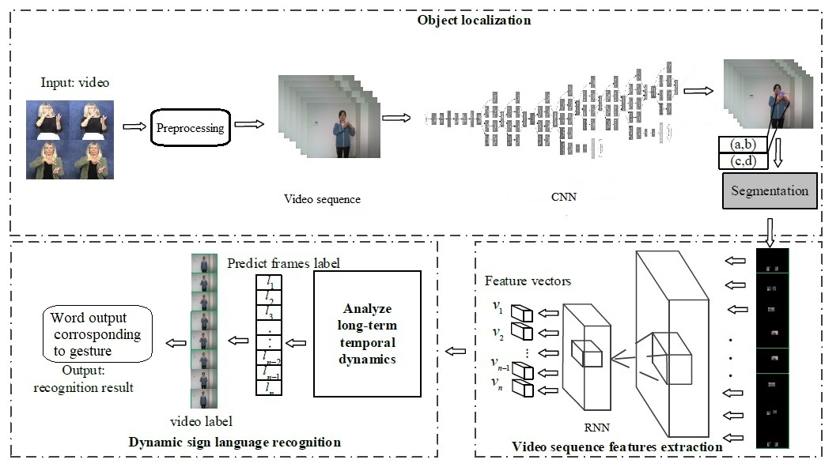
System Architecture

Slide 15
Proposed System
Phases of the System
Video acquisition & Pre-processing
The video acquisition of signer is obtained by web camera.
8 frames of video sequence is considered for a motion of single gesture.
In pre-processing Filtering, image enhancement, image resizing are performed.
For Pre-processing is done as part of Convolutional Neural Network.

Slide 16
Proposed System
Phases of the System
Object Localization
Object localization module based on CNN, which is used to capture the information of hand position.
Each layer of CNN will work on individual Frames from the segmented video. CNN will extract Region of Interest (ROI), Image Segmentation and Hand Detection.
CNN will compute spatial data in the form of Feature vector from the given input of video frames, this data is forwarded to RNN.

Slide 17
Proposed System
Phases of the System
Feature extraction
Feature vector extracted by CNN which contain spatial information are considered here as input. CNN extracts 8 Feature vectors for each gesture
Recurrent Neural Network is used for spatiotemporal feature extraction. RNN gives 1 spatiotemporal output for 8spacial input.
Classifier is a part of RNN which gives text as output.sss

Slide 18
Proposed System
Advantages of proposed system
Real-time functioning
Takes less time to describe a sentence compared to other existing systems.
No need to remember the spelling to describe a word.
Communication becomes faster.
No need for special Hardware.

Slide 19
Deep Learning based model performing Hand gesture recognition for Speech/Hearing impaired people to mimic natural way of communication was successfully implemented with accuracy comparable with those of recent contributions. The Proposed method takes gesture input as sequence of images and gives the output as a word in the form of text That helps to eliminate the communication barrier between Speech / Hearing impaired people. In future this model can be extended to gesture to speech translation. This method for individual gestures for word can also be extended for sentence level sign language.
Conclusion

Slide 20
References
P. V. V. Kishore, D. A. Kumar, A. S. C. S. Sastry and E. K. Kumar, "Motionlets Matching With Adaptive Kernels for 3-D Indian Sign Language Recognition," in IEEE Sensors Journal, vol. 18, no. 8, pp. 3327-3337, 15 April15, 2018, doi: 10.1109/JSEN.2018.2810449.
H. Muthu Mariappan and V. Gomathi, "Real-Time Recognition of Indian Sign Language," 2019 International Conference on Computational Intelligence in Data Science (ICCIDS), Chennai, India, 2019, pp. 1-6, doi: 10.1109/ICCIDS.2019.8862125.
T. Oliveira, N. Escudeiro, P. Escudeiro, E. Rocha and F. M. Barbosa, "The VirtualSign Channel for the Communication Between Deaf and Hearing Users," in IEEE Revista Iberoamericana de Tecnologias del Aprendizaje, vol. 14, no. 4, pp. 188-195, Nov. 2019, doi: 10.1109/RITA.2019.2952270.

Slide 21
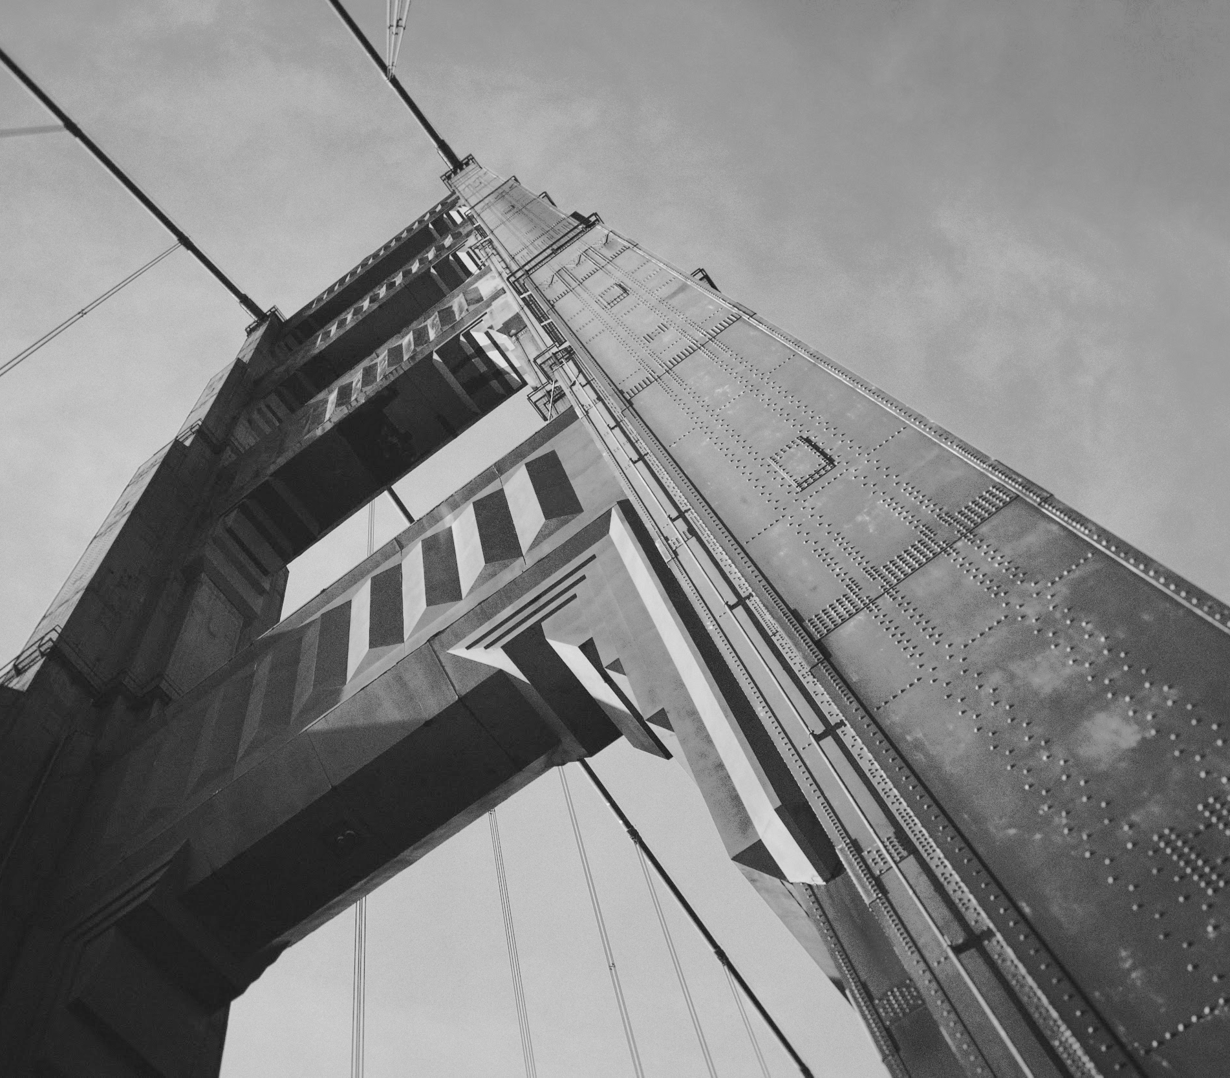
Thank you!

